Slide 1
Cassandra: a NoSQL Big Data Database System
Dr. Shiyong Lu
Big Data Research Laboratory
Department of Computer Science
Wayne State University
shiyong@wayne.edu

Slide 2
An Introduction of Cassandra
A leading transactional, scalable, and highly-available distributed database.
A scalable and fault-tolerant peer-to-peer architecture.
A versatile and flexible data model that evolved from the BigTable data model.
A declarative and user-friendly Cassandra Query Language, CQL.
High performance read and write.

Slide 3
The Cassandra Data Model
CREATE KEYSPACE Excelsior WITH REPLICATION = { 'class' : 'SimpleStrategy', 'replication_factor' : 3 };
Keyspace: A database schema in Cassandra is represented by a keyspace that serves as a top-level namespace where all other data objects, such as tables, reside.
Tables: Within a keyspace, a set of CQL tables is defined to store and query data for a particular application.

Slide 4
Create a Keyspace
cqlsh> CREATE KEYSPACE lukeyspace1 WITH
REPLICATION = { 'class' : 'SimpleStrategy', 'replication_factor' : 1 };
cqlsh> use lukeyspace1
cqlsh> SELECT * FROM system.schema_keyspaces;
cqlsh> exit;

Slide 5
Create a table
CREATE TABLE emp( emp_id int PRIMARY KEY, emp_name text,
emp_city text, emp_sal varint, emp_phone varint );
SELECT * FROM emp;

Slide 6
Insert data into table
cqlsh:lukeyspace1> INSERT INTO emp (emp_id, emp_name, emp_city, emp_phone, emp_sal) VALUES(1,'ram', 'Hyderabad', 9848022338, 50000);
cqlsh:lukeyspace1> INSERT INTO emp (emp_id, emp_name, emp_city, emp_phone, emp_sal) VALUES(2,'robin', 'Hyderabad', 9848022339, 40000);
cqlsh:lukeyspace1> INSERT INTO emp (emp_id, emp_name, emp_city, emp_phone, emp_sal) VALUES(3,'rahman', 'Chennai', 9848022330, 45000);
cqlsh:lukeyspace1> SELECT * from emp;
cqlsh:lukeyspace1> SELECT * from emp WHERE emp_id = 3;

Slide 7
Read data from a table
A WHERE clause can be used only on the columns that are a part of primary key or have a secondary index on them.
cqlsh:lukeyspace1> SELECT * from emp;
cqlsh:lukeyspace1> select * from emp where emp_sal = 50000;
InvalidRequest: code=2200 [Invalid query] message="No secondary indexes on the restricted columns support the provided operators: “
cqlsh:lukeyspace1> CREATE INDEX ON emp(emp_sal);
cqlsh:lukeyspace1> select * from emp where emp_sal = 50000;
emp_id | emp_city | emp_name | emp_phone | emp_sal
--------+-----------+----------+------------+---------
1 | Hyderabad | ram | 9848022338 | 50000
2 | Delhi | robin | 9848022339 | 50000

Slide 8
Insert data into table
cqlsh:lukeyspace1> INSERT INTO emp (emp_id, emp_name, emp_city, emp_phone, emp_sal) VALUES(1,'ram', 'Hyderabad', 9848022338, 50000);
cqlsh:lukeyspace1> INSERT INTO emp (emp_id, emp_name, emp_city, emp_phone, emp_sal) VALUES(2,'robin', 'Hyderabad', 9848022339, 40000);
cqlsh:lukeyspace1> INSERT INTO emp (emp_id, emp_name, emp_city, emp_phone, emp_sal) VALUES(3,'rahman', 'Chennai', 9848022330, 45000
cqlsh:lukeyspace1> SELECT * from emp;
cqlsh:lukeyspace1> SELECT * from emp WHERE emp_id = 3;

Slide 9
Update Data
cqlsh:lukeyspace1> SELECT * from emp;
cqlsh:lukeyspace1> UPDATE emp SET emp_city='Delhi',emp_sal=50000 WHERE emp_id=2;
cqlsh:lukeyspace1> SELECT * from emp;

Slide 10
Delete Data
cqlsh:lukeyspace1> SELECT * from emp;
cqlsh:lukeyspace1> DELETE emp_sal FROM emp WHERE emp_id=3;
cqlsh:lukeyspace1> SELECT * from emp;
cqlsh:lukeyspace1> DELETE FROM emp WHERE emp_id=3;
cqlsh:lukeyspace1> SELECT * from emp;

Slide 11
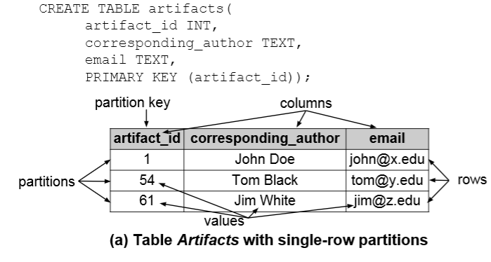
Single-row partition

Slide 12
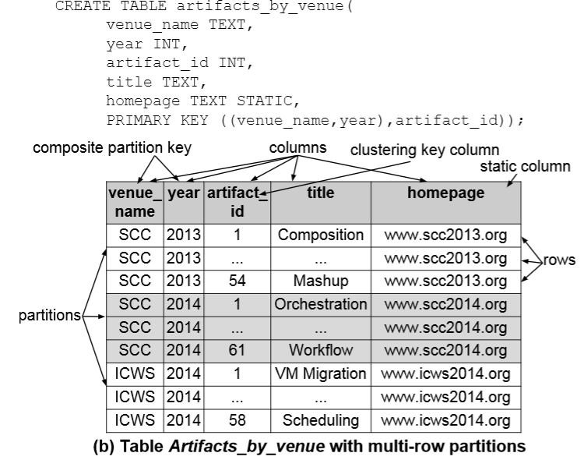
Multiple-row partitions

Slide 13
Cassandra Query Restrictions
Each CQL query involves one table exactly.
The where clause consists of a prefix p of the ordered columns of the primary key; no other columns can occur in the where clause.
The where clause must contain equality conditions for all partition key columns.
Only the last column of p can be involved in a inequality condition, provided that the column is a clustering key column.

Slide 14
CQL Example
Retrieve all rows of a partition (specified by restricting all partition key columns)
SELECT artifact_id, title
FROM artifacts_by_venue
WHERE venue_name=‘SCC’ AND year=2013

Slide 15
CQL Example
Retrieve some rows of a partition (specified by restricting all partition key columns, and then restricting a clustering key column artifact_id)
SELECT artifact_id, title
FROM artifacts_by_venue
WHERE venue_name=‘SCC’ AND year=2013 AND
artifact_id >=1 AND artifact_id <=20;

Slide 16
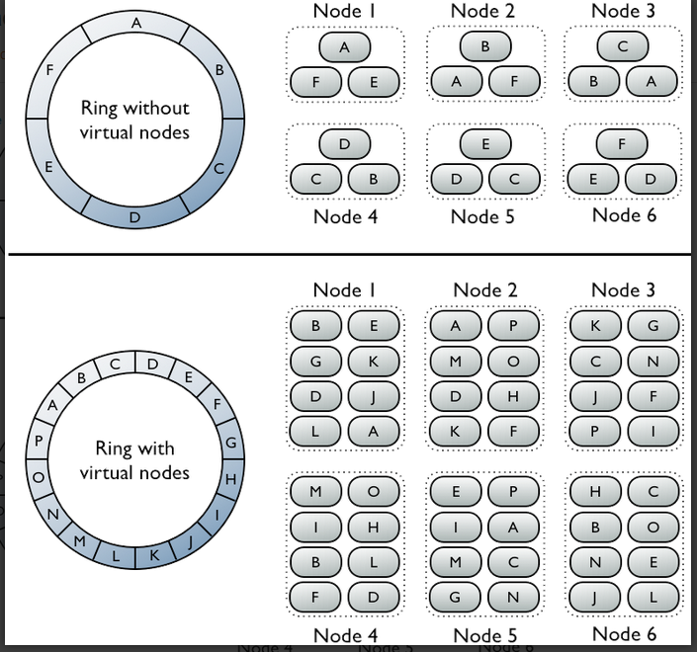
Data distribution in Cassandra cluster

Slide 17
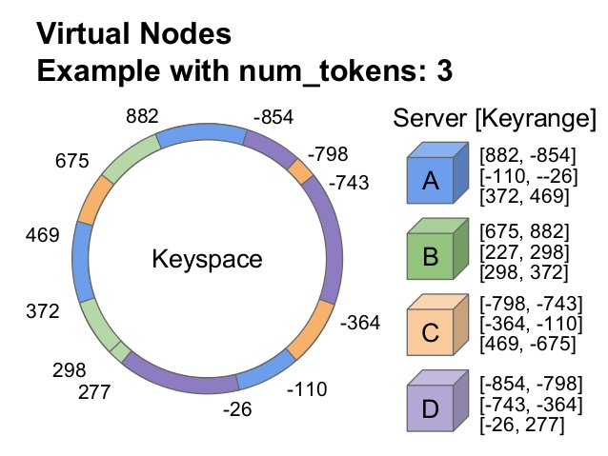
Data Distribution Using Virtual Nodes

Slide 18
Cassandra Partitioners
A partitioner decides how data is distributed across the nodes in the cluster (including replicas).
A partitioner is a hash function that computes the hash value (token) of a partition key.
Three partitioners: Murmur3Partitioner (default), RandomPartitioner and ByteOrderedPartitioner.

Slide 19
How to Install Cassandra
in a Machine with Ubuntu

Slide 20
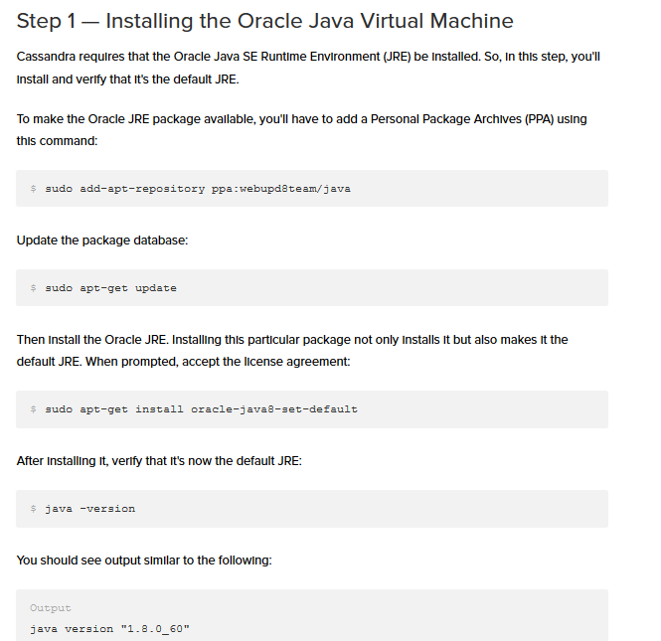
Step 1: Installing Oracle Java
$ sudo add-apt-repository ppa:webupd8team/java
$ sudo apt-get update
$ sudo apt-get install oracle-java8-set-default
$ java -version

Slide 21
Step 2: Adding the repo
We'll install Cassandra using packages from the official Apache Software Foundation repositories, so start by adding the repo so that the packages are available to your system. Note that Cassandra 2.2.2 is the latest version at the time of this publication. Change the 22x to match the latest version. For example, use 23x if Cassandra 2.3 is the latest version:
$echo "deb http://www.apache.org/dist/cassandra/debian 22x main" | sudo tee -a /etc/apt/sources.list.d/cassandra.sources.list
$echo "deb-src http://www.apache.org/dist/cassandra/debian 22x main" | sudo tee -a /etc/apt/sources.list.d/cassandra.sources.list

Slide 22
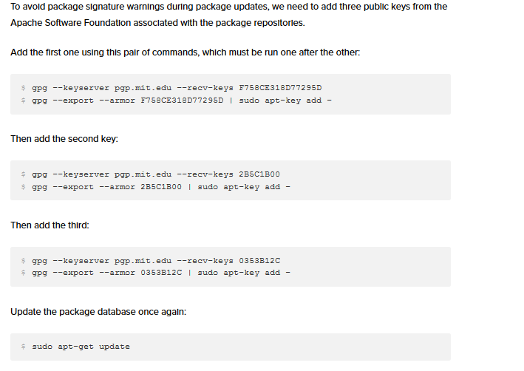
Step 3: Adding three public keys
$ gpg --keyserver pgp.mit.edu --recv-keys F758CE318D77295D
$ gpg --export --armor F758CE318D77295D | sudo apt-key add -
$ gpg --keyserver pgp.mit.edu --recv-keys 2B5C1B00
$ gpg --export --armor 2B5C1B00 | sudo apt-key add -
$ gpg --keyserver pgp.mit.edu --recv-keys 0353B12C
$ gpg --export --armor 0353B12C | sudo apt-key add -
$ sudo apt-get update

Slide 23
Step 4: Install Cassandra
$ sudo apt-get update
$ sudo apt-get install cassandra
$ sudo service cassandra status
* Cassandra is running
$ sudo nodetool status

Slide 24
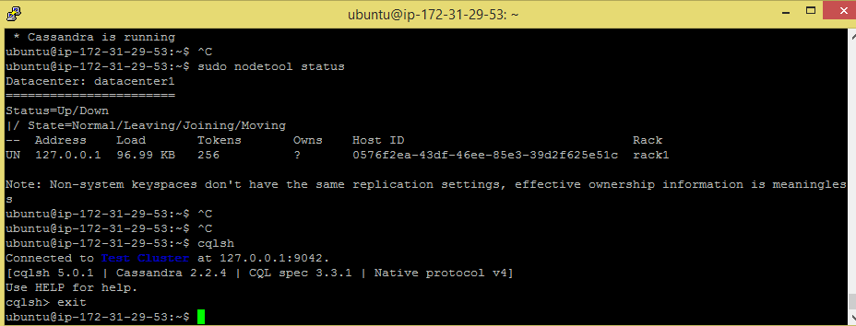
Running CQL shell

Slide 25
What version is My Cassandra?
select peer, release_version from system.peers;
select release_version from system.local;
release_version
-----------------
2.2.4

